Slide 1


http://www.euromoneythoughtleadership.com/ghostsinthemachine/

Slide 2
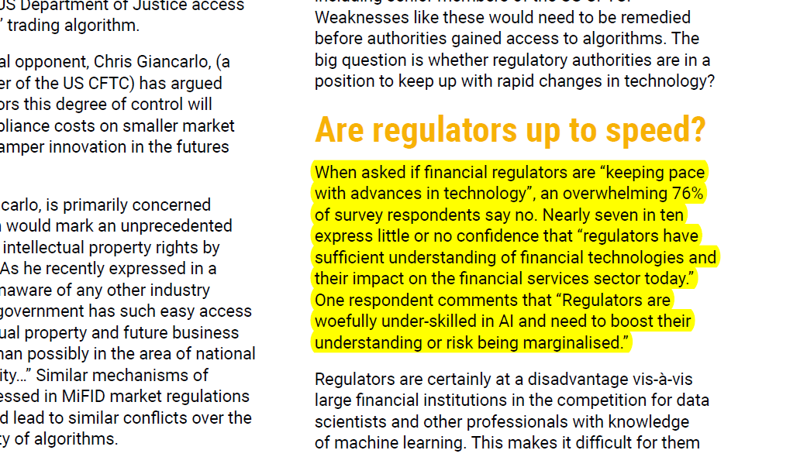
http://www.euromoneythoughtleadership.com/ghostsinthemachine/

Slide 3
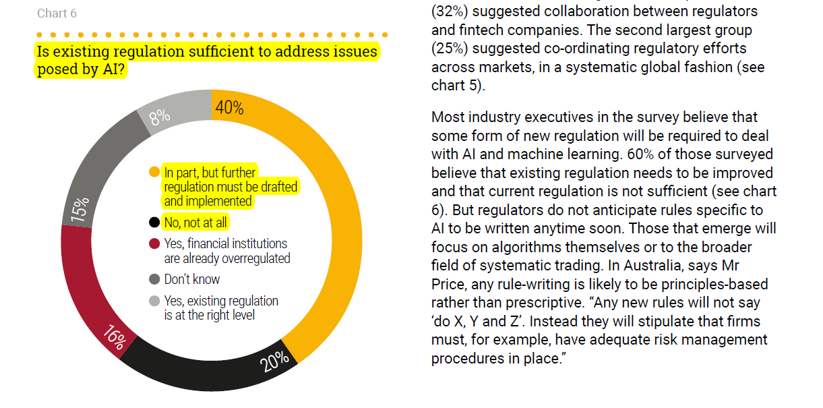
http://www.euromoneythoughtleadership.com/ghostsinthemachine/

Slide 4
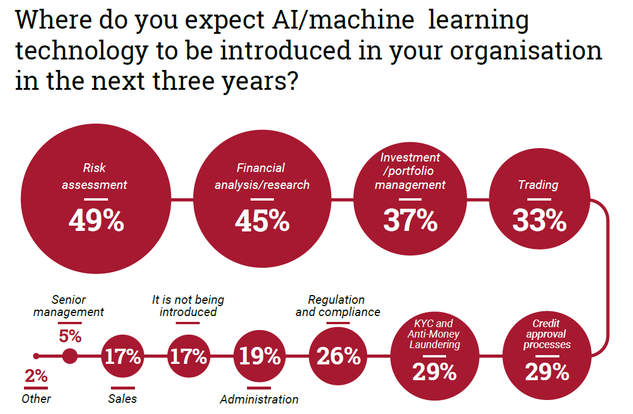
http://www.euromoneythoughtleadership.com/ghostsinthemachine/

