Slide 1
How Crooks use Good Markets to do Bad Things
CSTA 23rd Annual Conference

Slide 2
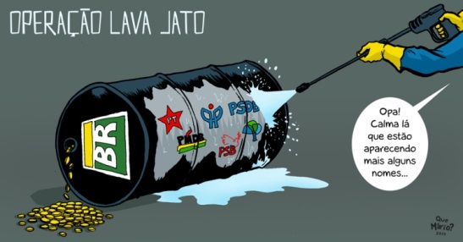
Working at the Car Wash…
Notes:
The Impacts of Corruption and Money Laundering

Slide 3
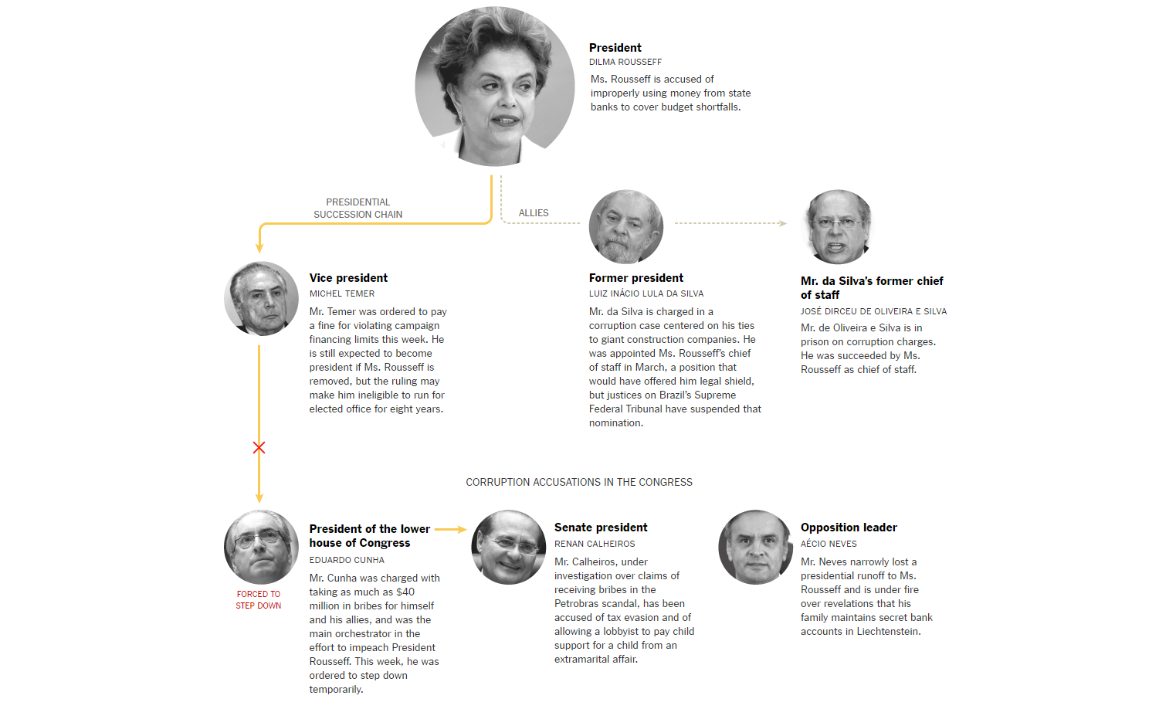
http://www.nytimes.com/interactive/2016/03/17/world/americas/corruption-scandals-in-brazil-reach-all-the-way-to-the-top.html

Slide 4
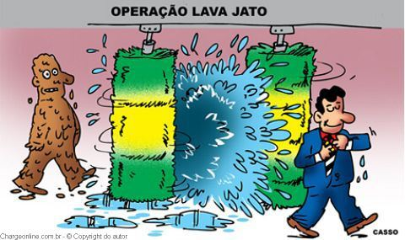
Operacao Lava Jato: The Petrobas Scandal
Funds tracked through Posto da Torre Car Wash in Brasilia.
Investigators Uncovered R$ 6.2 Billion in Bribes.
Over $100 Million Funneled to Swiss Bank Accounts by Black Market Money Dealers.
Allegations of Funds used to pay-off Coalition and Fund Election Campaigns
179 People Charged with Criminal Offences and 93 Convicted.
Notes:
The Impacts of Corruption and Money Laundering

Slide 5

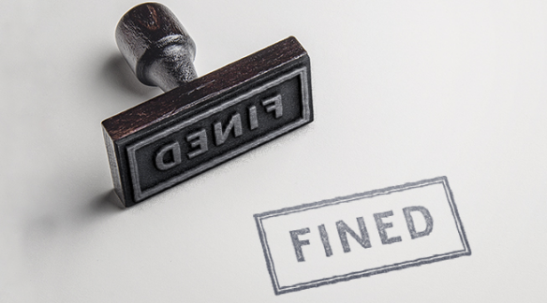
On the Radar: Broker Dealer Fined for AML
Broker Dealer agreed to pay $17 Million in Fines in 2016.
Firm’s Compliance Officer faces three-month Suspension and pays $25,000 in Fines.
Significant Systematic Failures in Anti-Money-Laundering Compliance Requirements.
Failed to establish and implement adequate procedures to “detect, investigate and report suspicious activity” between 2011-2014.
Largest Fine Levied by Regulator for Alleged Anti-Money Laundering Issues.
Previously Fined $400,000 in 2012 for Failing to Detect Ponzi Scheme between 2005-2007.

Slide 6
Regulators: Cracking the Whip
BNP Parisbas
$8.9 Billion
UBS
$6.3 Billion
Credit Suisse
$2.6 Billion
HSBC
$1.9 Billion
Commerzbank
$1.45 Billion
SEC
(As of January 2016
Charged 198 Entities & Individuals.
Charged 89 CEOs, CFOs & Other Senior Corporate Officers
FINRA
Issues between 1,300 & 1,600 Disciplinary Actions each year.
In 2014, Barred/Suspended approx. 1,200 Individuals & 23 Firms.
Barred 53 Individuals from Positions, Industry & Commission Suspension.
Order over $3.76 billion in Penalties, Disgorgements & Other Monetary Relief.
In 2014, order $134 million in Fines & $32.2 million in restitution.
Has Referred over 700 cases to other Federal/ State Agencies.
Notes:
However, fines like the one on Raymond James is just the tip of the iceberg. According to the Boston Consulting Group in 2014 alone it is estimated that U.S. and European Financial Institutions have paid over $65 billion dollars in fines to Regulators.

Slide 7
Why Does it Matter? Because Regulators Say So.
Andrew Ceresney, Director of the SEC’s Division of Enforcement:
  “Brokerage Firms must take their anti-money laundering responsibilities seriously so they can serve as a line of defense against misconduct and market risk.”

Slide 8
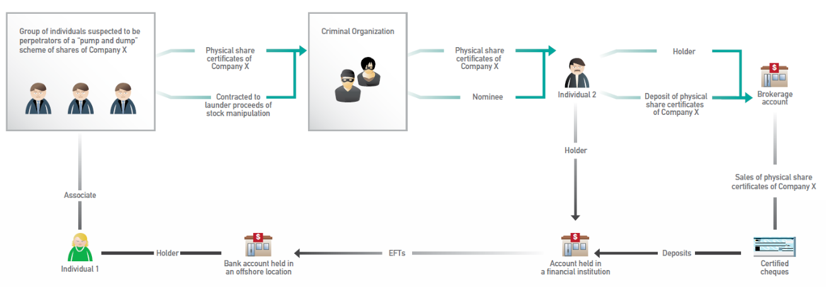
Identifying Red Flags: Pump and Dump
  Source: http://www.fintrac-canafe.gc.ca/publications/typologies/images/2013-04/English/Case1_Big_ENG.png
Notes:
Explain two major AML Red Flags when it comes to Securities and Broker Dealers: (1) Pump and Dump Scheme

Slide 9
Identifying Red Flags:
  Thinly Traded or Low Value Securities (Pump – and – Dump)
  Master/ Sub Account Relationships
  Comprehensive Asset Management or Cash Management

Slide 10
Red Flags
In 2002, U.S. National Association of Securities Dealers developed a series of sign for suspicious activity to the securities field:
    The Customer appears to be acting as an agent for an undisclosed principles, but declines or is reluctant, without legitimate commercial reason, to provide information, or is otherwise evasive regarding that person or entity.
    For no apparent reason, the customer has multiple accounts under a single name or multiple names, with a large number of inter-account or third-party transfers.
    The customer’s account has unexplained or sudden extensive wire activity, especially in accounts that had little or no previous activity.
    The customer makes a funds deposit for the purpose of purchasing a long-term investment followed shortly thereafter by a request to liquidate the position and transfer the proceeds from the account.
    The customer engages in excessive journal entries between unrelated accounts without any apparent business purpose.
    The customer requests that a transaction be processed in such a manner so as to avoid the firm’s normal documentation requirements.
    Engages in transactions involved securities such as: penny stocks, Regulation S (Reg S) stockss, and bearer bonds.
    The customer’s account shows an unexplained high level of activity with very low levels of securities transactions.

