Slide 1
COMMODITY TRADING AND WHAT IT MEANS TO EQUITIES
Hosted by Rob McBride
Energy Markets Specialist, Bloomberg LP

Slide 2
Guests
  Yves Martin
        Managing Director, Risk Management Solution Group
        National Bank Of Canada
  Corey Riley
  Vice President, Marketing
  Nexen Energy

Slide 3
Supply & Demand influences

Slide 4
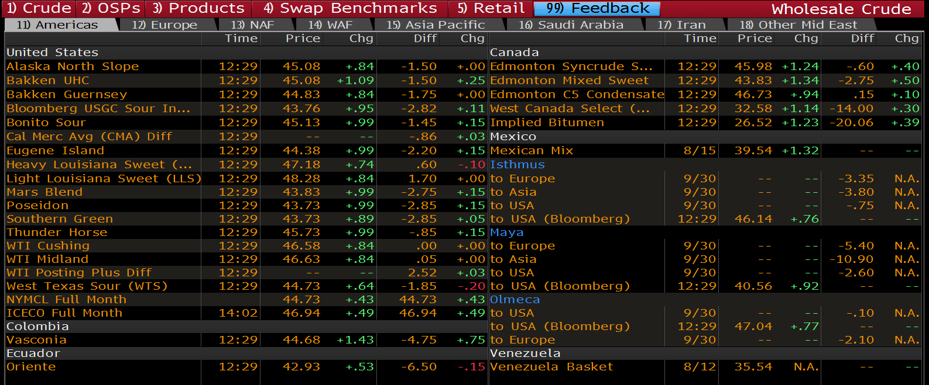
Commonly Quoted Crudes IN AMERICAS

Slide 5
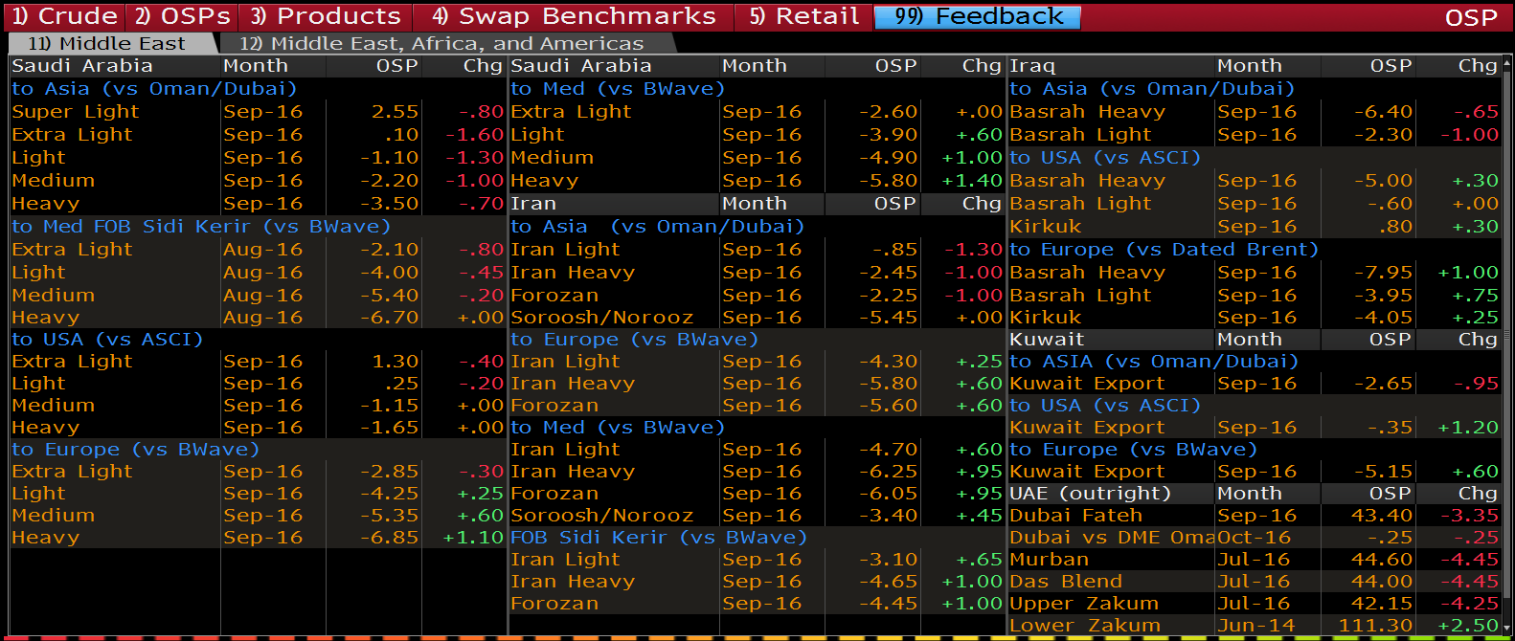
MIDDLE EAST OSP

Slide 6
Pipeline Market Theoretically Simple
Northern Tier
Bakken/WCS/Syn
Chicago
Mid-Continent
WTI
Gulf Coast
LLS
Brent
Notes:
Will not spend a lot of time on international – it is a waterborne business which CNOOC is very familiar with, but would like to talk about the North American pipeline business.

Slide 7
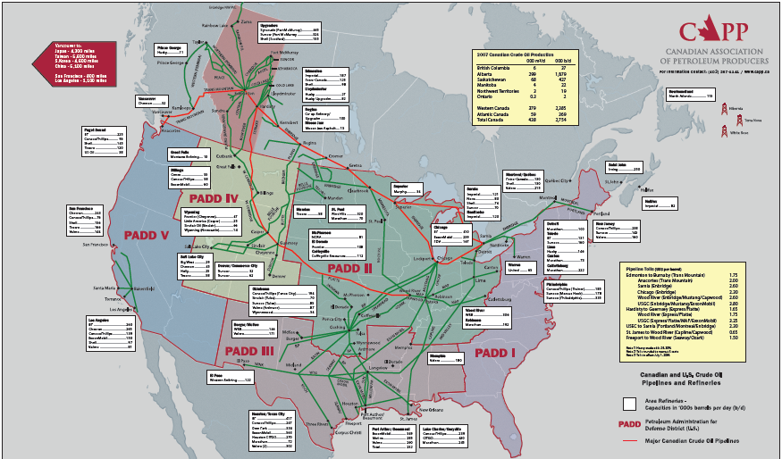
Logistically – Highly Complex

Slide 8
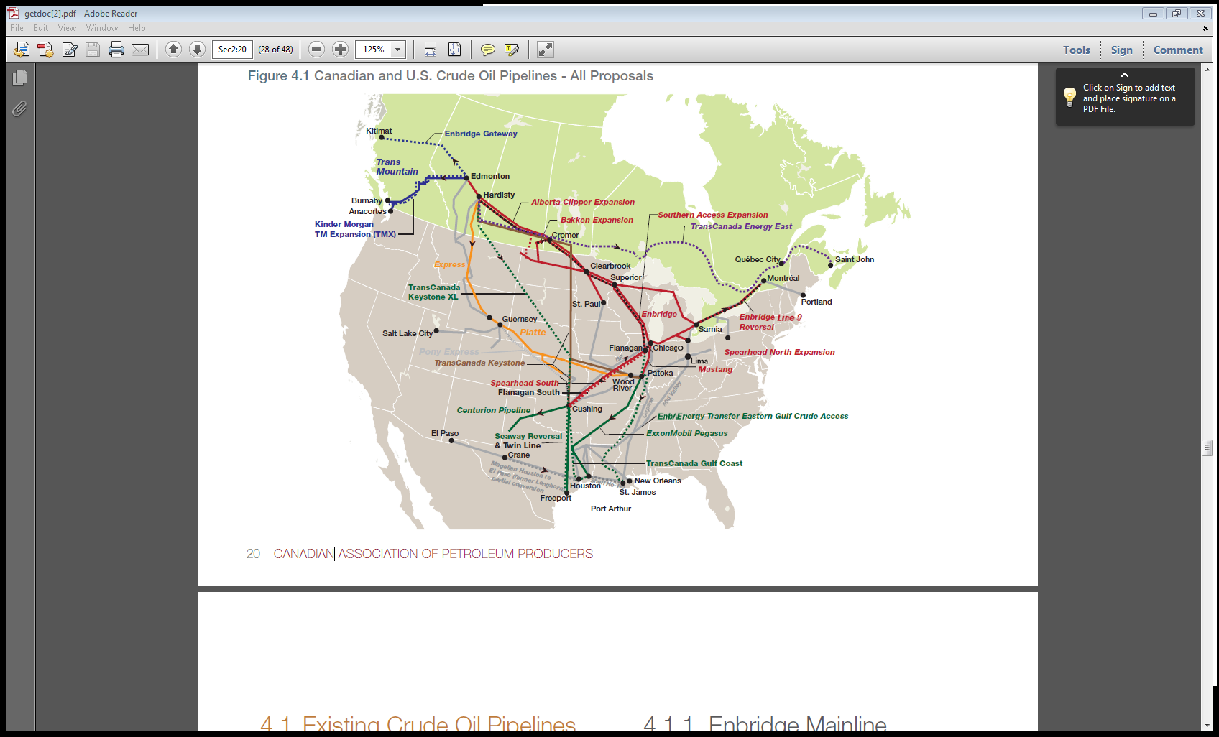
Market Access – Logistics matter
Canadian production ~3 mmbpd with 2.3 mmbpd exported
98% of exports move into the US Mid-Continent
North American market is ~18 mmbpd with 46% in US Gulf Coast
Canadian barrels are landlocked today moving largely by pipe
Global market is ~90 mmbpd with more than 50% on tidewater
North American market is unique globally with complex network
of pipelines and large percentage of barrels land locked
Notes:
And reality….
North America infrastructure is a complex web:
Coastal refineries on the West Coast (California) and East Coast (New Jersey / Pennsylvania) have traditionally relied on offshore tanker imports
Western Canadian crude supply (3.1 mmbd) is surplus to its own indigenous refinery demand (~0.7 mmbd), so the surplus is moved to other refinery centres
Enbridge Mainline is the main outlet running from Edmonton into Chicago an up into Ontario (thruput 725 kbd Light; 1025 kbd Heavy; Total 1750 kbd)
Keystone pipeline began shipping from Hardisty to Patoka in 2010 and to Cushing in 2011 – capacity 590 kbd
With the lack of takeaway capacity and growth in production in recent years – we are faced with pipeline apportionment.
In Canada the pipelines have historically been common carrier, that is anyone can ship, just nominate your production.
Spolied for year with excess transport capacity, producers have historically NOT backstopped pipelines
Times have changed dramatically with the entrance of take or pay such as keystone, Trasn mountain expansion, Gateway & Energy East.
In summary, logistics are critical to land locked Canadian production and play a significant role in price.

Slide 9
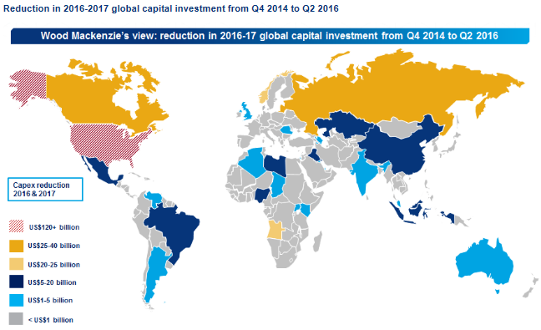
Declining GLOBAL investment

Slide 10
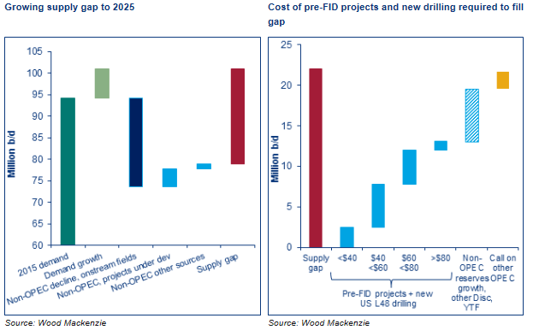
Declining investment = supply Gap

Slide 11
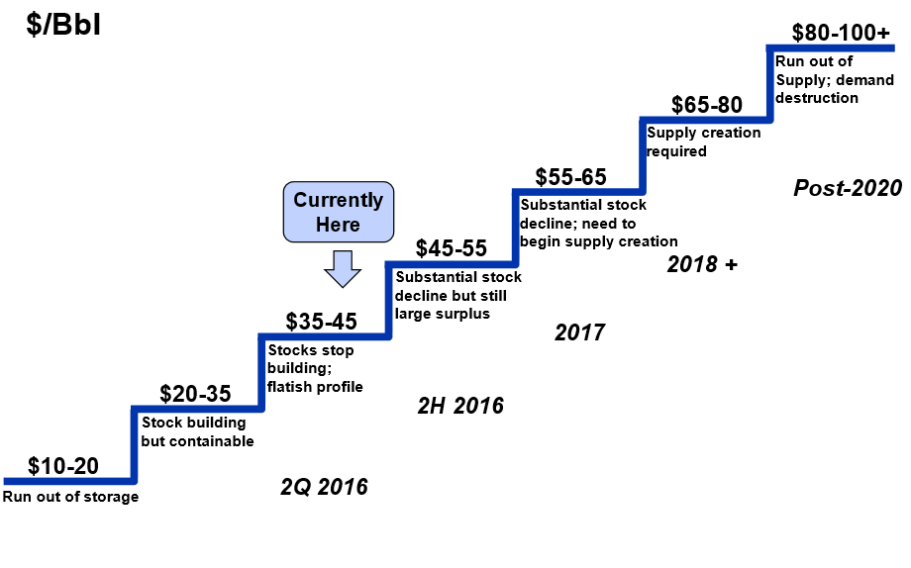
Price Drives investment
?
*Source: PIRA

Slide 12
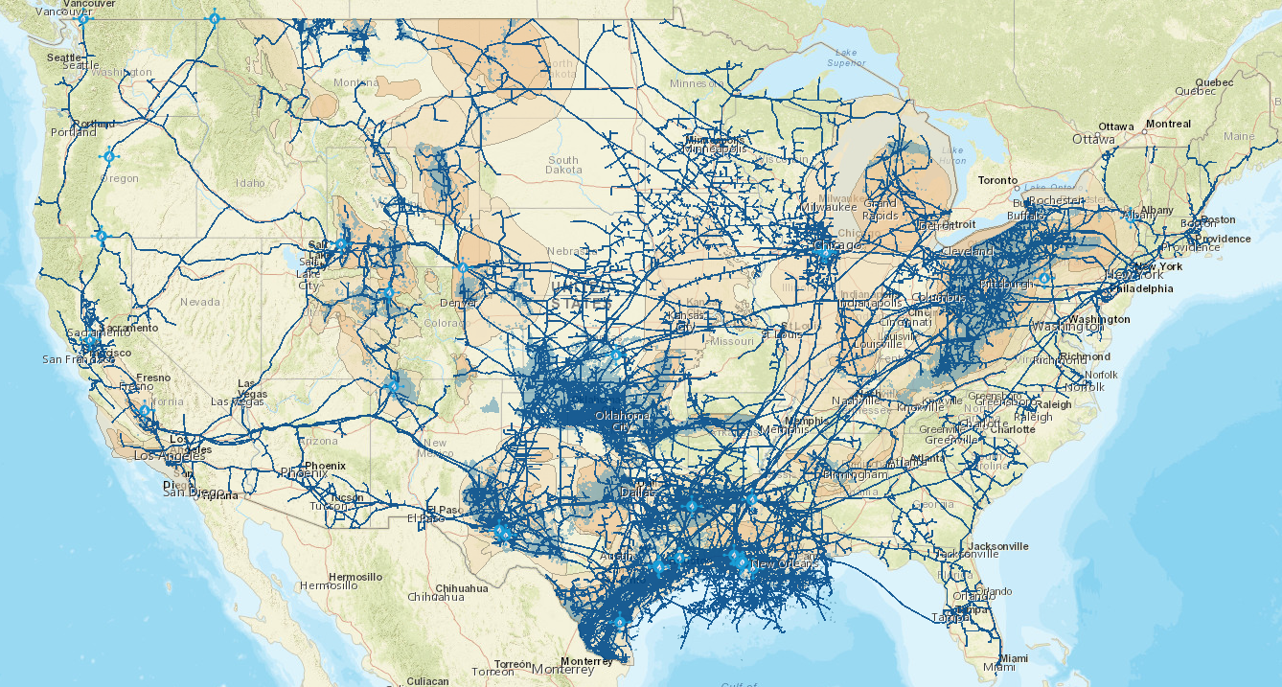
Natural Gas Infrastructure

Slide 13
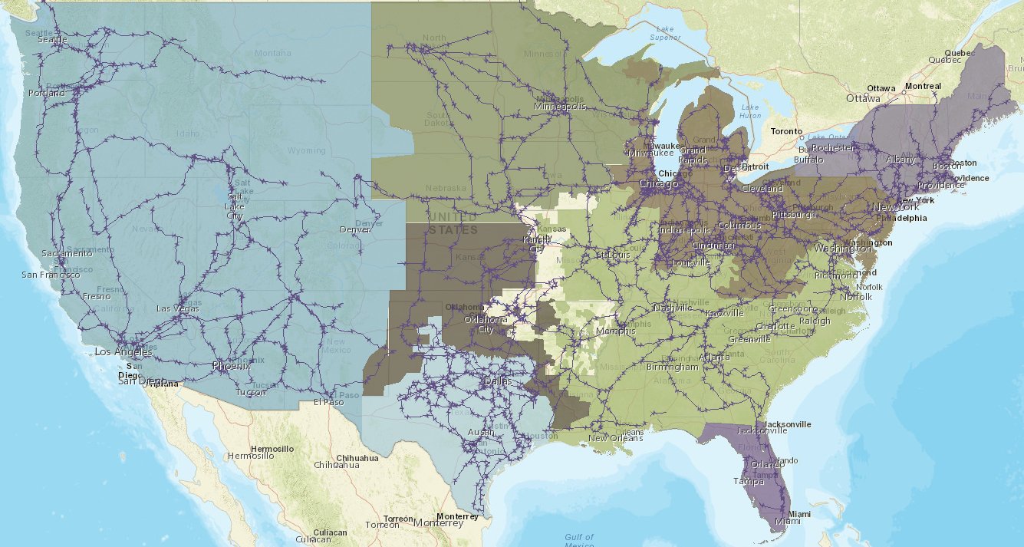
Electric Grid Backbone lines
Pacific Coach Lines

Slide 14
What to know about contract rolls

Slide 15
Term Structure of Commodity futures
  Factors affecting shape of a commodity curve
  Costs
    Storage
    Insurance
    Financing
  Perceived balance
    Supply
    Demand
  Total Return = Price Return + Roll Return

Slide 16
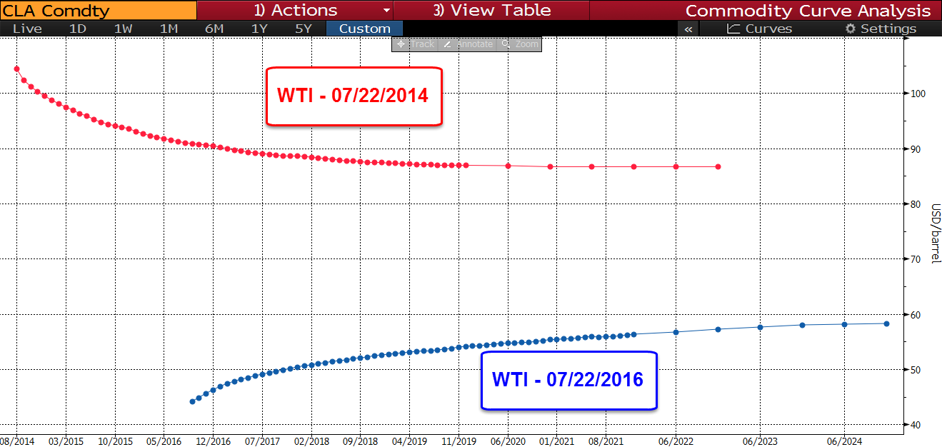
Term Structure of Commodity futures
  Contango
    Gradual erosion of capital
    Negative roll yield
  Backwardation
    Gradual appreciation of capital
    Positive roll yield

Slide 17
Term structure of Commodity Futures
Rolling Curve
  Negative or positive roll yield
  Possibility of cash and carry
Seasonal Curve
  No rolling along the forward curve
  Spot price and front month contract converge

Slide 18
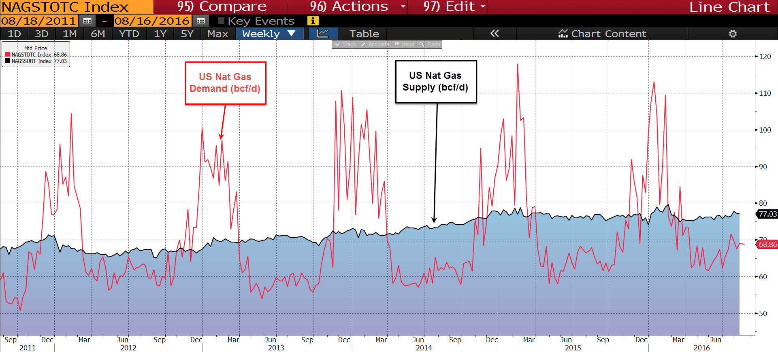
Term Structure of Commodity futures

Slide 19
Term structure of Commodity Futures
  Commodities with significants shifts in supply/demand balance throughout the year and storing capacity limitations exhibit seasonality in their forward curves.
  Rolling curves
    Crude Oil
    Copper
  Seasonal curves
    Natural Gas
    Soybeans

Slide 20
Producers v Speculators

Slide 21
Commodity Market Properties and Players
Some individual commodity curves are in fact three different markets with participants who have their own agenda:
98
96
94
92
90
88
sept.-12
sept.-13
sept.-14
sept.-15

Slide 22
Commodity Market Properties and Players (cont’d)
Commodity Trading Advisors (CTA):
  Usually short term trend following or in rarer cases fundamentally driven
  Concentrated in the shorter expiry contracts with the higher volumes and higher open interest
Index Investors:
  Passive money (~$350 B) and most have to trade spreads on a set schedule (roll schedule)
  On the plain vanilla indices such as the DJUBS or S&P-GSCI Index the schedule is public and the volumes traded are massive
  The spread trading is concentrated in the front of the curve, but new “optimized yield” indices have now started to shift the focus a little further back
Producers and Consumers:
  Hedging programs from producers and consumers occurs mostly in the back of the curve
  The back of the curve is less traded so some producers “push” the forward curve down when they activate their selling programs
  It is common for producer selling to occur over several days
  Some producers are now shifting their hedges from futures or future lookalikes to option collars (short calls, long puts)

Slide 23
Historical Price and Long/Short positions - WTI
Source: Bloomberg as of August 11th, 2016

Slide 24
Credit Risk

