Slide 1
Not So fast
Peter Kovac
Author, Not So Fast
A Critical Examination of the Flash Boys Controversy

Slide 2
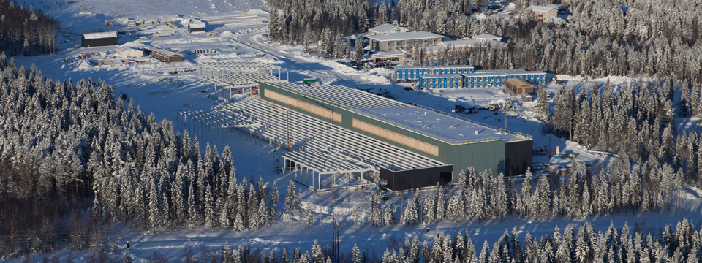



Technology and the Markets
Facebook Data Center
Luleå, Sweden
Notes:
Another pillar of the ”rigged” argument is the use of technology. This preys on our natural suspicion of technology, especially anyone who seems to know it better than we do.
Flash Boys starts with a story of tunneling underground to lay fiber optic cable, and moves on to massive data centers filled with faceless cold computers. Why would anyone pay for all this technology unless there was something suspicious going on, Michael Lewis asks.
Anybody recognize this data center? Facebook.
computers in here are custom-built; unique data fabric network architecture
Flash Boys portrays data centers, colocation and custom networks as sinister HFT devices. In fact,
these are common techniques for all tech companies.
Facebook spends maybe $500mm per year on data centers, Google more than $3bb.
Located in Sweden. Built to reduce latency for European users.
Flash Boys portrays the existence of NJ data centers as sinister – why did they choose to build them outside NY?
You could ask the same question of Facebook: why Lulea and not, say, Stockholm? Cost. Energy is cheap in Lulea. Real estate is expensive in Stockholm (more so than Manhattan)
Relatively speaking, most financial firms don’t spend that much on technology
* We ordered our computers from Dell and HP
* Monthly cost for Spread Networks (the firm in Flash Boys that tunneled through the mountains): about the operating costs of a single McDonald’s franchise

Slide 3
Flash Boys: The Case of AMGN
AMGN @ $48
AMD @ $48
AMD @ $48, and $4

Slide 4
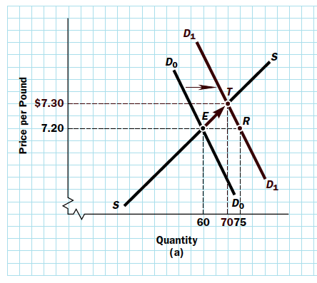

AMGN & Econ 101: “I’m The Event”
Source: Macroeconomics, Baumol and Blinder

Slide 5
Lewis’ “Flash Trap Bait”
10:00:04.937 200 MSFT 41.57 NSDQ
10:00:04.937 300 MSFT 41.57 NSDQ
10:00:04.937 94 MSFT 41.57 BZX
10:00:04.937 100 MSFT 41.57 BZX
10:00:04.937 67 MSFT 41.57 EDGX
10:00:04.937 500 MSFT 41.57 ARCA
10:00:04.937 100 MSFT 41.57 ARCA
10:00:04.941 200 MSFT 41.56 NSDQ
10:00:04.941 300 MSFT 41.56 NSDQ
10:00:04.944 100 MSFT 41.56 NSDQ
10:00:06.224 200 MSFT 41.57 BZX
10:00:06.224 100 MSFT 41.57 BYX
10:00:06.224 100 MSFT 41.57 BOS
10:00:06.226 100 MSFT 41.57 BYZ
10:00:06.229 100 MSFT 41.57 EDGX
10:00:06.229 200 MSFT 41.57 EDGX
10:00:06.229 100 MSFT 41.57 NSDQ
10:00:06.229 100 MSFT 41.57 NSDQ
10:00:06.229 100 MSFT 41.57 NSDQ
10:00:06.229 400 MSFT 41.57 NSDQ
10:00:06.229 500 MSFT 41.57 NSDQ
10:00:06.229 100 MSFT 41.57 EDGX
10:00:06.229 100 MSFT 41.565 PHLX
10:00:06.229 100 MSFT 41.57 NSDQ
10:00:06.229 100 MSFT 41.57 NSDQ
10:00:06.229 100 MSFT 41.57 NSDQ

Slide 6
Lewis’ “Flash Trap Bait”
10:00:04.937 200 MSFT 41.57 NSDQ
10:00:04.937 300 MSFT 41.57 NSDQ
10:00:04.937 94 MSFT 41.57 BZX
10:00:04.937 100 MSFT 41.57 BZX
10:00:04.937 67 MSFT 41.57 EDGX
10:00:04.937 500 MSFT 41.57 ARCA
10:00:04.937 100 MSFT 41.57 ARCA
10:00:04.941 200 MSFT 41.56 NSDQ
10:00:04.941 300 MSFT 41.56 NSDQ
10:00:04.944 100 MSFT 41.56 NSDQ
10:00:06.224 200 MSFT 41.57 BZX
10:00:06.224 100 MSFT 41.57 BYX
10:00:06.224 100 MSFT 41.57 BOS
10:00:06.226 100 MSFT 41.57 BYZ
10:00:06.229 100 MSFT 41.57 EDGX
10:00:06.229 200 MSFT 41.57 EDGX
10:00:06.229 100 MSFT 41.57 NSDQ
10:00:06.229 100 MSFT 41.57 NSDQ
10:00:06.229 100 MSFT 41.57 NSDQ
10:00:06.229 400 MSFT 41.57 NSDQ
10:00:06.229 500 MSFT 41.57 NSDQ
10:00:06.229 100 MSFT 41.57 EDGX
10:00:06.229 100 MSFT 41.565 PHLX
10:00:06.229 100 MSFT 41.57 NSDQ
10:00:06.229 100 MSFT 41.57 NSDQ
10:00:06.229 100 MSFT 41.57 NSDQ

Slide 7
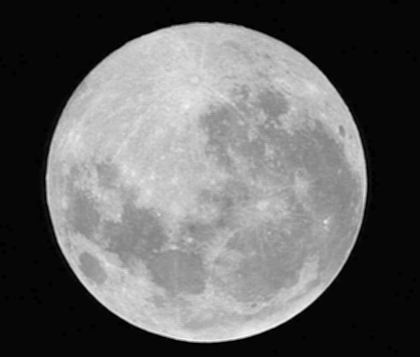

Flash Traps, “Broker Tells,” & Prediction

Slide 8
Flash Traps: Guess How Many Shares

Slide 9
Price manipulation doesn’t pay

Slide 10
Some Things Flash Boys Missed
(not a complete list!)
Order Protection Rule
Bid-Offer Spread
Price-Time Priority
Competition
Computers aren’t that smart

Slide 11
Flash Trap Bait: Market Data
100
100
100
100
100
100
100
100
100
100
100
100
100
100
100
10,000 SPY @ 207.80
10,000
10,000
10,000
10,000
10,000
10,000
10,000
10,000
10,000
10,000
10,000
10,000
10,000
10,000
10,000
10,000
10,000
10,000
10,000
10,000
10,000
10,000
10,000
10,000
10,000
10,000
10,000
10,000
10,000
10,000
10,000 SPY @ 207.80
10,000 SPY @ 207.80
10,000 SPY @ 207.80
10,000 SPY @ 207.80
100 SPY @ 207.80

Slide 12
Flash Boys’ experts weigh in
“One possibility is that HFTs merely react to public information faster than everyone else...a second possibility is that the HFTs simply front-run coming demand when they can predict future orders. However, I find neither of these hypotheses to be consistent with the data.”
— Adam Clark Joseph, “Exploratory Trading”,
academic research cited by Flash Boys.

Slide 13
More experts weigh in
Sweden: van Kervel & Menkveld (2015)
Canada: Korajczyk & Murphy (2015)
  No HFT front-running
  Actually, HFT absorbs aggressive institutional orders
  HFT “late to the party” when trading with large orders

Slide 14
Flash Boys on “Proof”
“…for the same reason that no one could prove that high-frequency traders were front-running the orders of ordinary investors. The data didn’t exist.”
– Flash Boys, Chapter 3
None of Flash Boys’ allegations of front-running are substantiated by a single shred of market data.

Slide 15
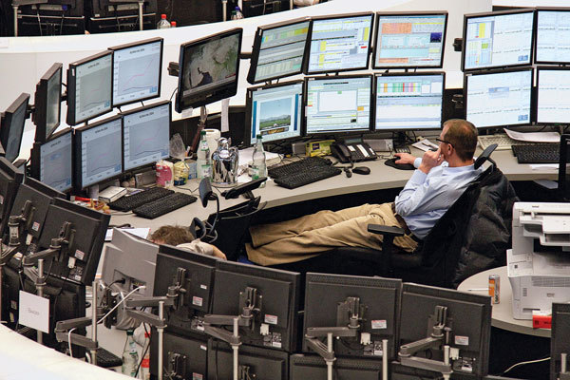
Does the Data Exist?

Slide 16
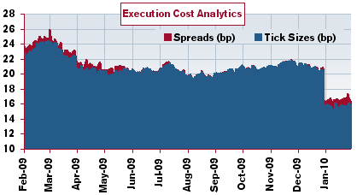
Latency Experiment (2010)
Tokyo cuts matching latency from ~3 seconds to ~2 milliseconds
Lower latency ➔ Reduced risk ➔ Better prices
Source: Credit Suisse Portfolio Strategy; Reuters

Slide 17
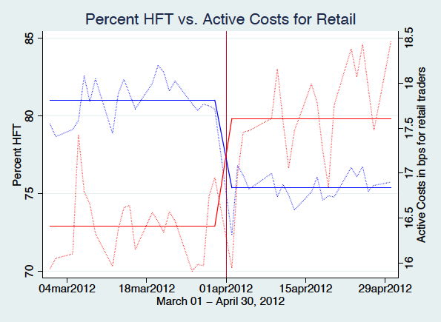
HFT Experiment (2012)
IIROC imposes a new fee that curtails HFT
Curtailing HFT increased costs for retail investors
Source: Malinova et al (2012)

Slide 18
IEX Experiment (2014)
According to IEX:
  HFT provides significant liquidity on IEX
  HFT is “a good contributor of value to our market”

Slide 19
Wrapping Up / Looking Ahead
Markets aren’t rigged, but we can still do better:
  Market fragmentation
  Market center complexity (e.g. order types)
  Role of off-exchange activity and payment for order flow
  Continued enforcement

Slide 20
Final Thoughts
50 bps

Slide 21
Questions?

Slide 22
Appendices

Slide 23
Flash Boys 2.0: Trading Costs
Source: ITG reports (2005-2014)

Slide 24
Flash Boys 2.0: Trading Costs
ITG IS Costs (bps)
Source: ITG reports (2005-2014)

Slide 25
Flash Boys 2.0: Trading Costs
ITG IS Costs (bps)
Source: ITG reports (2005-2014)

Slide 26
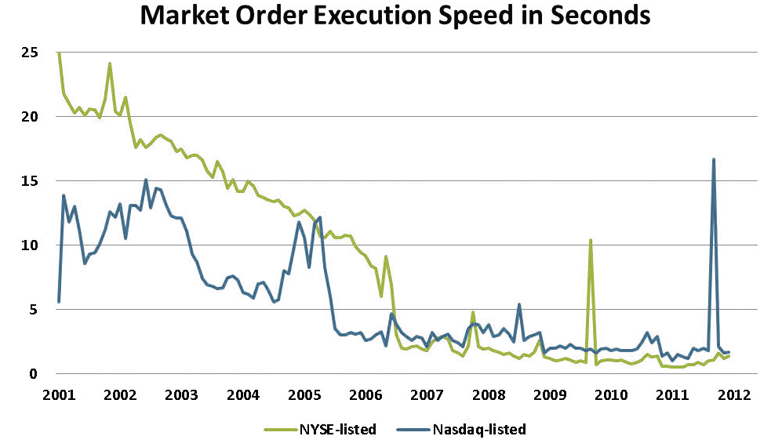
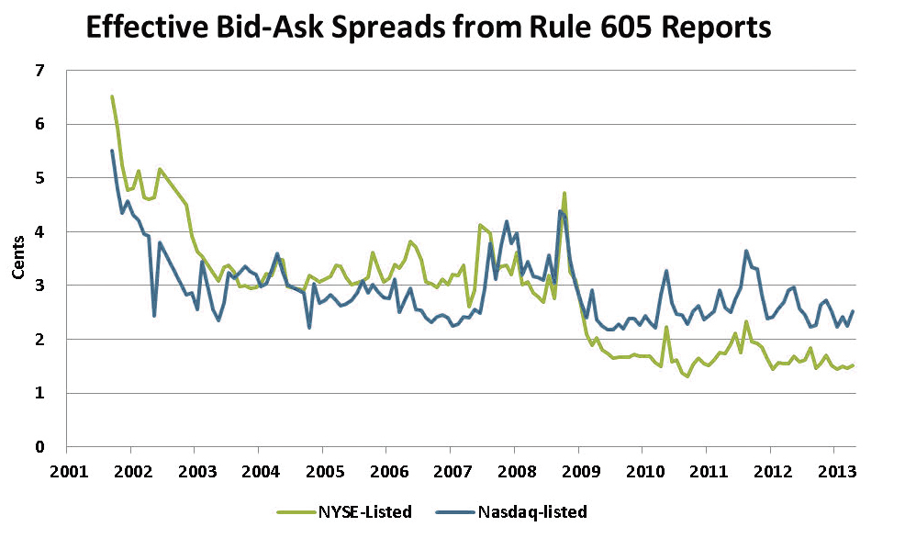
Latency and Spreads
Source: Angel, Harris Spat (2013)

Slide 27
Market Data and the SIP
What is the SIP?
  Can you trade on the SIP?
    No. Trades occur on market centers.
  Is it slower than the direct feeds?
    Yes, any consolidated feed would be
  Does that matter to me?
    Probably not.
Where can I get perfect market data?
  Nowhere I know. All data is relative to the observer’s location. Fortunately, it’s probably good enough.

